Slide 1


CounterFactual Models
CENTRE FOR DEVELOPMENT
OF
APPLIED AI LAB.
(CDAAIL)
Prof. SK Udgata and team.
CENTRE FOR DEVELOPMENT OF APPLIED AI LAB.
(CDAAIL)

Slide 2
Contents :-
1) What are the Different Models? ( based on Interpretability).
2) What are CounterFactual models and Explanations ?
3) CounterFactual Explanations and Generative Adversarial Network.
3) Mathematical Modelling of CounterFactual Models.
4) CounterFactual Research work Based on “Birth Data Files” taken from “Centers for Disease Control and Prevention” (CDC), US dept of Health.

Slide 3
Types of Models based on Interpretability :-
GlassBox Models :- “Glass-Box models” are interpretable due to their structures and are completely exposed to the users. Eg :- Linear Models, Decision Trees.
BlackBox Models :- “Black-Box models” do not disclose anything about the internal design, structures of implementations. Eg :- Deep Neural Networks, SVM (Support Vector Machine), Random Forests, Gradient Boosting.
For Model Explainability the below Python Libraries we have used.
1) LIME Explanation :- Gives Local Explanations,
2) SHAP Explanation :-Gives Global Explanations

Slide 4
2) What are CounterFactual models and Explanations ?
“Countering the Facts of observed outputs(Effects)”, by making some changes in inputs(Cause).
A counterfactual explanation of a prediction describes the smallest changes to the feature values that changes the prediction to an observed output in users favour.
“If I would not have smoked, I might not be getting cancer”.
“If I had studied harder, I would have passed the exam”.
By using the CounterFactual models we make the BlackBox models to Glass-Box by explaining the reasons for the results.
“What features need to be changed and by how much to flip a model’s prediction?” (i:e to reverse an unfavorable outcome).

Slide 5
3) CounterFactual Explanations and Generative Adversarial Network(GAN).
Counterfactuals concepts are from (GANs) which are generative models, they create new data instances that resembles our training data and so CFS.
CFSs is one of the(minimum) solution from all the set of the solutions.

Slide 6
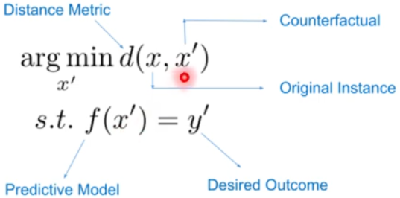
4) Mathematical Modelling of CounterFactual Models.
Mathematically this is a optimization problem and our objective is to find x’ which is the counterfactual sample that changes the prediction of our black box model to a target class y’.
Our purpose is to find f(x’) that change the prediction to desirable class y’.
We know f(x)=y & f(x’)=y’.
We need to find the i/p x’ so that it will fall into y’.
Choice of distance metric dictates what kinds of counterfactual are chosen.

Slide 7
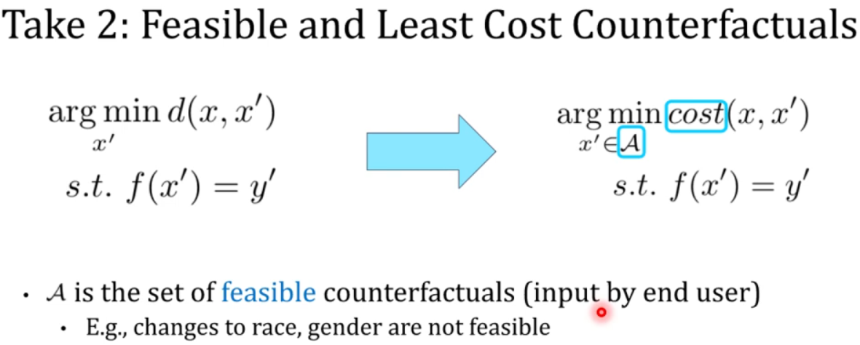
Feasibility of CounterFactuals Models. [ Usten et al 2019 ]
It is not always possible to change some of features eg :- Race, Gender or Color etc.
We take the feasible solutions from the a set A, which is the set of all the counterfactuals inputs.
Cost function tells that how much it is difficult to go from x→ x’ ?
The ‘d’ is the Manhattan distance.

Slide 8
Problem in the CounterFcatuals Generated. [Usten et el 2019]
The counterfactuals are biased against Age, Gender, Race.
Some CounteFactuaks are not feasible to act upon these features. As one cannot act upon these features.
So, our Algo should generate the feasible counterfactuals to act upon.
They used a strategy where x’ should be pick up from the set of feasible counterFactuals
Developed a Strategy where end user should inputs a set o counterfactuals and x’ should be chosen from that set of feasible counterfactuals.

Slide 9
Finding 3 :- Causally Feasible Counteactuals or Attributes Dependency or Interactions among attributes. [Mahajan et al ]
It is important to account for feature interactions when generating counterfactuals.
They are considering new distance metric d_causal(x,x’) , they suggested to use the SCM ( Structure Causal Model ) to define this new distance metric
This underlying causal models captures the feature interactions.

Slide 10
Global CounterFactual Explanations : [ Rawal et al 2020 ]
Useful for regulators to ensure that there should be not any bias against a particular community or race in AI model before implementing it on real-life situations.
Global counterfactual explanations are useful to know the behavior of the overall model.
They aggregate the Local CounterFcatuals to generate the Global counterFactuals.
For certain demography the model is asking to change lot more features than others.
So, Global counterfactuals are useful to find out any bias in model.

Slide 11
Dataset Description :-
“BirthsFinal Data for 2022”. Published by “Centres for disease control and prevention (CDC) . ( U.S. DEPARTMENT OF HEALTH AND HUMAN SERVICES ).

Slide 12
WORKFLOW :
We have 5.0 GB of Birth Data File taken form https://www.cdc.gov/nchs/data_access/vitalstatsonline.htm
Divide into 15 subfiles contains strings of 330.1 MB.
Preprocess these 15 sub-files to .csv files.
Combined all these 15 files. Each of (38744×214).
Chosen the useful columns from from these 214 columns.
71 Inputs columns,
Found that 62 columns which are useful.
61 Input Columns, 1 Output column as “Condition”
Condition= ”0” means
Condition= ”1” means

Slide 13
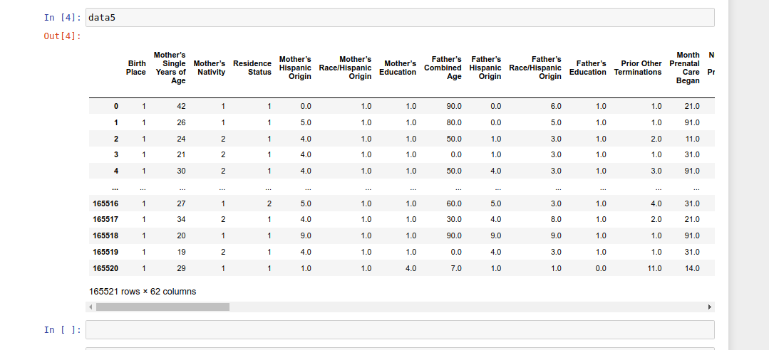
INPUT DATA :

Slide 14
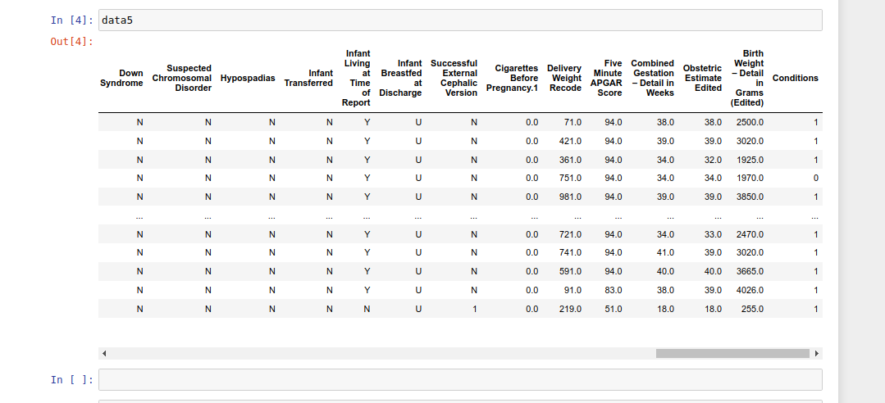
INPUT DATA :

Slide 15
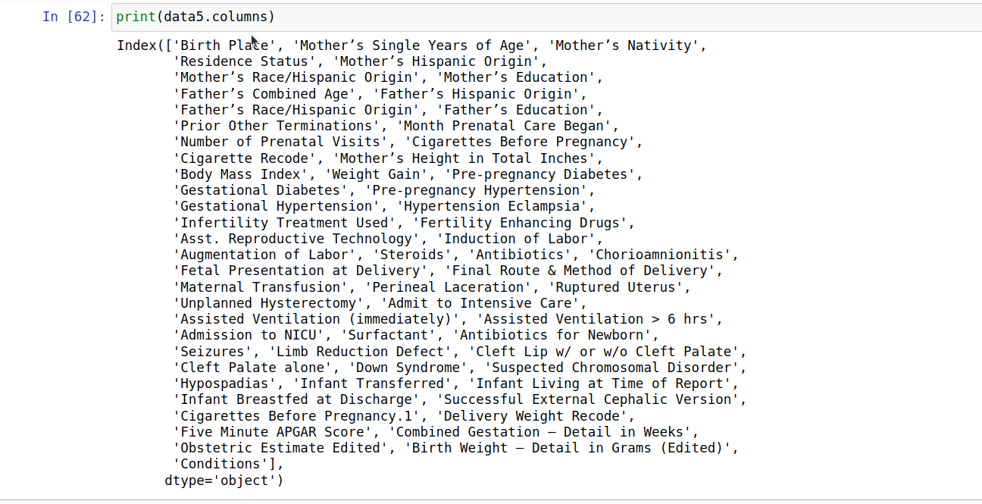
CATEGORICAL COLUMNS :

Slide 16
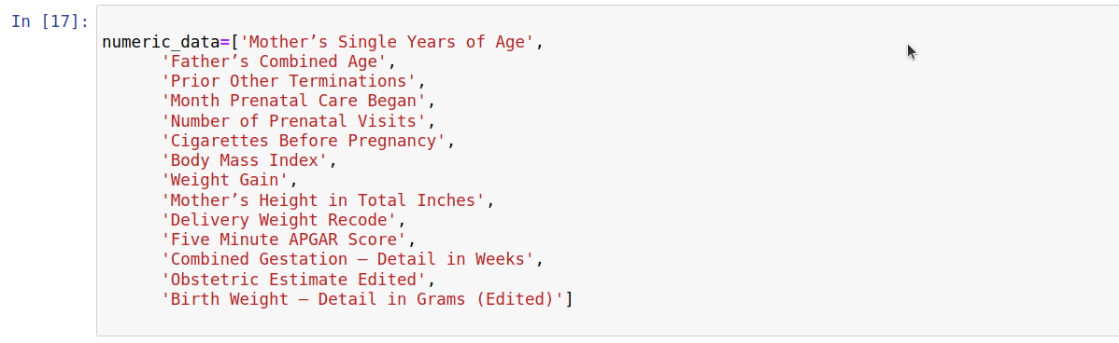
NUMERIC COLUMNS :

Slide 17
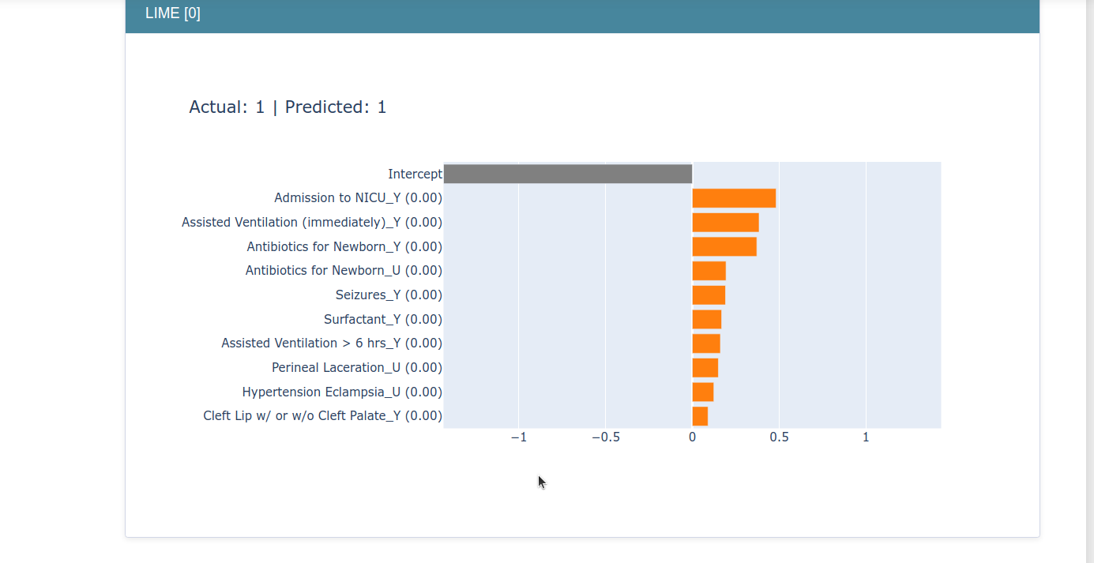
LIME OUTPUT :

Slide 18
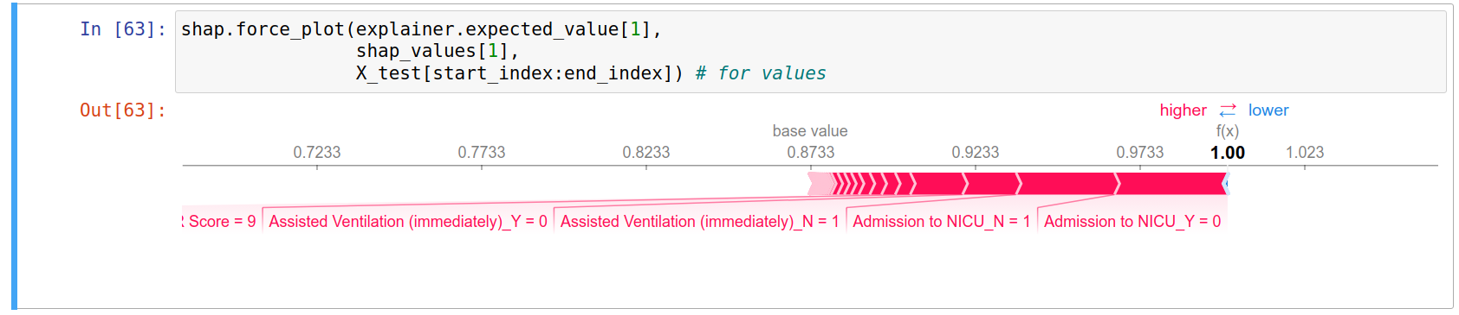
SHAP OUTPUT :

Slide 19
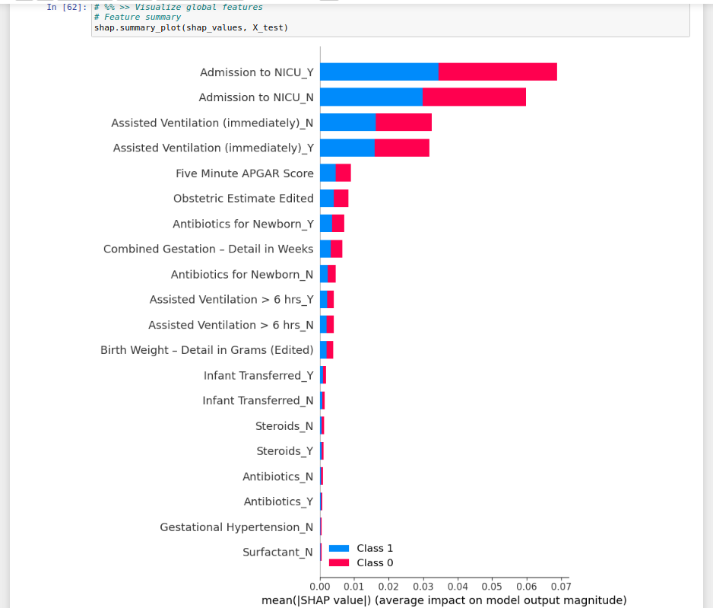
SHAP OUTPUT :

Slide 20
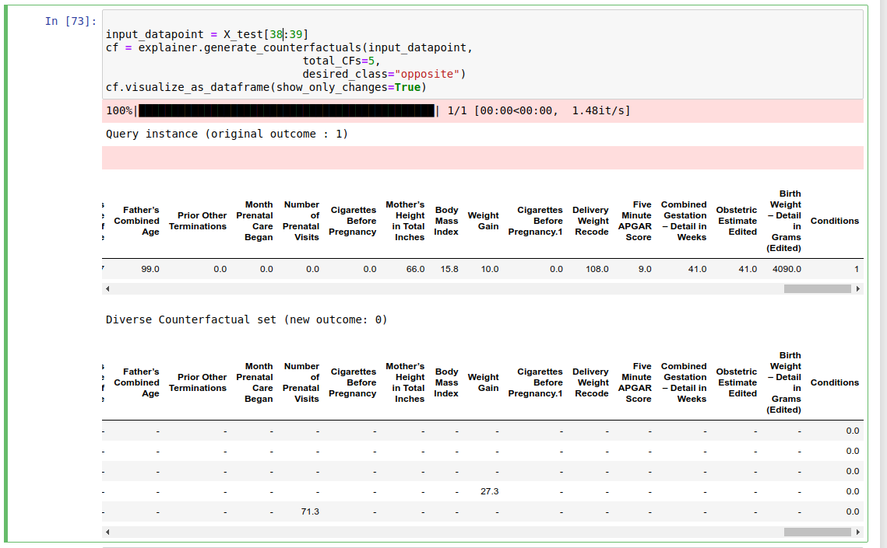
COUNTERFACTUAL GENERATIONS :
0-1 CLASS CHANGE

Slide 21
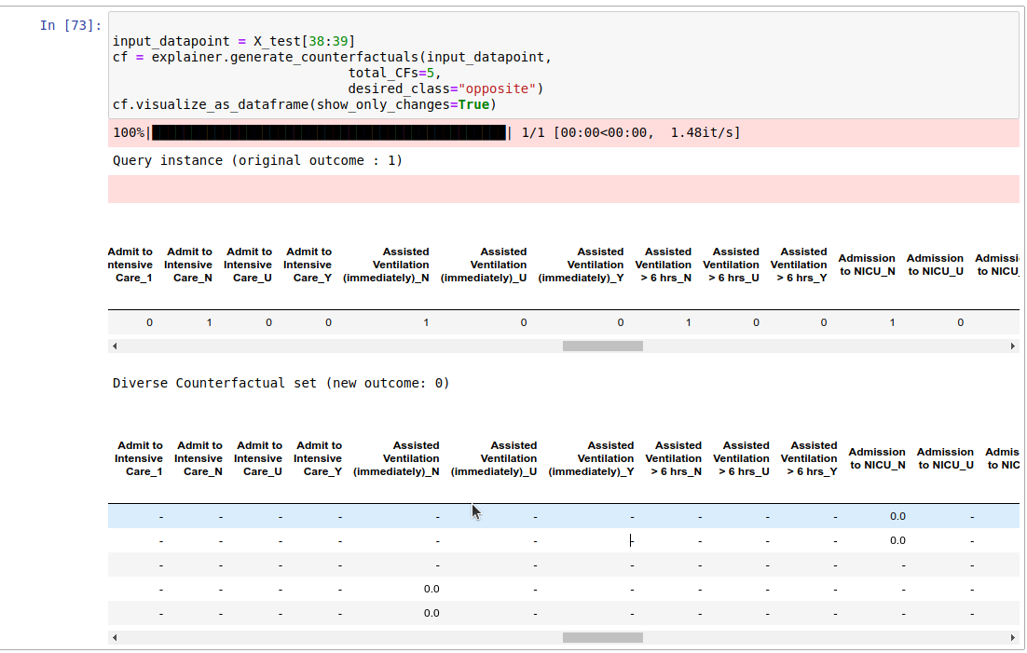
0-1 FEATURES CHANGE :

Slide 22
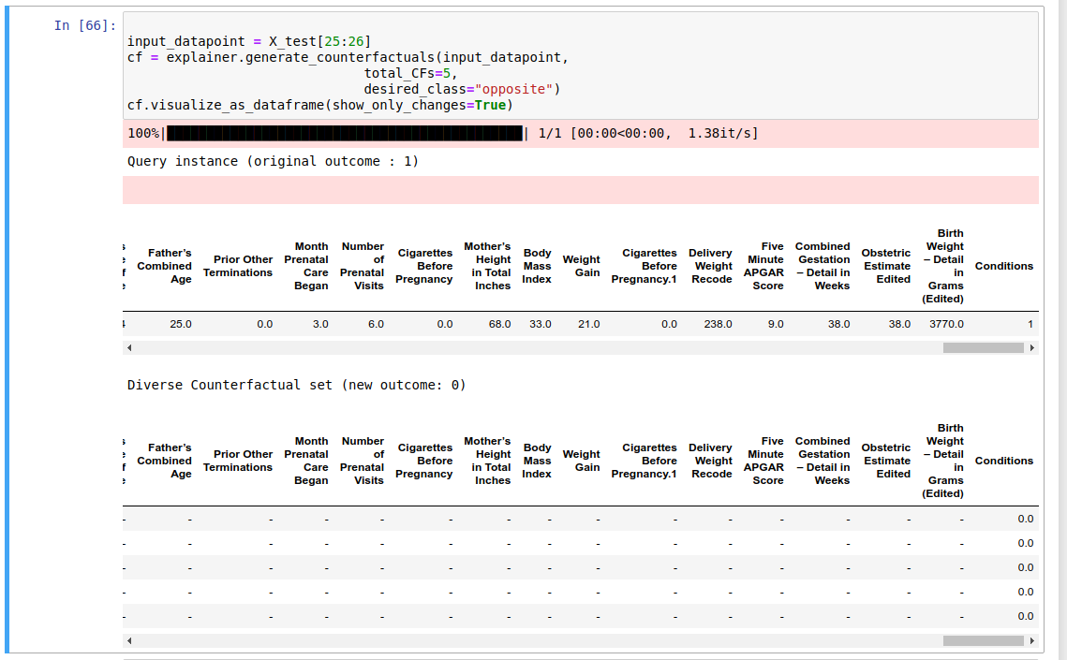
1-0 CLASS Change

Slide 23
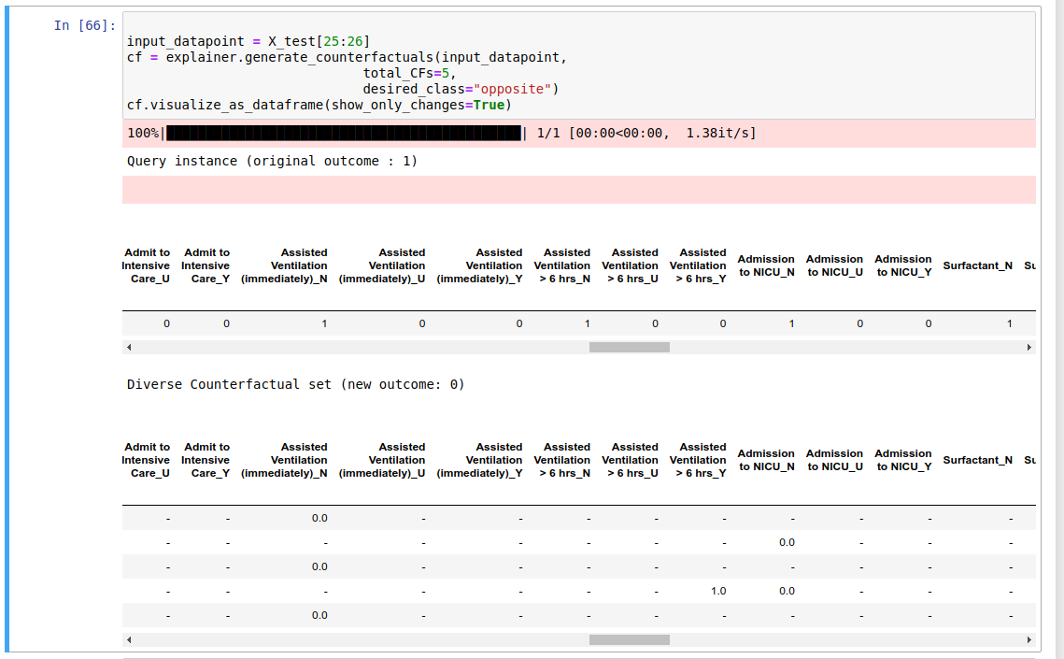
1-0 FEATURES CHANGE

Slide 33
Categorical_Data :-
Categorical_cols =
['Birth Place', 'Mother’s Nativity','Residence Status','Mother’s Hispanic Origin','Mother’s Race/Hispanic Origin','Mother’s Education','Father’s Hispanic Origin','Father’s Race/Hispanic Origin','Father’s Education','Pre-pregnancy Diabetes','Gestational Diabetes','Pre-pregnancy Hypertension','Gestational Hypertension','Hypertension Eclampsia','Infertility Treatment Used','Fertility Enhancing Drugs','Asst. Reproductive Technology','Induction of Labor','Augmentation of Labor','Steroids','Antibiotics','Chorioamnionitis','Maternal Transfusion',
'Perineal Laceration','Ruptured Uterus','Unplanned Hysterectomy','Admit to Intensive Care','Assisted Ventilation (immediately)', … ]

Slide 34
Categorical_Data_continue :-
Categorical_cols_continue =
['Assisted Ventilation > 6 hrs','Admission to NICU','Surfactant','Antibiotics for Newborn','Seizures','Limb Reduction Defect','Cleft Lip w/ or w/o Cleft Palate','Cleft Palate alone','Down Syndrome','Suspected Chromosomal Disorder','Hypospadias','Infant Transferred','Infant Living at Time of Report','Infant Breastfed at Discharge','Successful External Cephalic Version']

Slide 35
Numerical_Data :-
Numerical_cols =
[ 'Mother’s Single Years of Age','Father’s Combined Age','Prior Other Terminations','Month Prenatal Care Began','Number of Prenatal Visits',
'Cigarettes Before Pregnancy','Body Mass Index','Weight Gain','Mother’s Height in Total Inches','Delivery Weight Recode','Five Minute APGAR Score',
'Combined Gestation – Detail in Weeks','Obstetric Estimate Edited',
'Birth Weight – Detail in Grams (Edited)' ]

Slide 36
Input_Data :-
Input_cols =
[ 'Mother’s Single Years of Age','Father’s Combined Age','Prior Other Terminations','Month Prenatal Care Began','Number of Prenatal Visits',
'Cigarettes Before Pregnancy','Body Mass Index','Weight Gain','Mother’s Height in Total Inches','Delivery Weight Recode','Five Minute APGAR Score',
'Combined Gestation – Detail in Weeks','Obstetric Estimate Edited',
'Birth Weight – Detail in Grams (Edited)' ]

Slide 37
Input_Data :-
Numerical_cols =
[ 'Mother’s Single Years of Age','Father’s Combined Age','Prior Other Terminations','Month Prenatal Care Began','Number of Prenatal Visits',
'Cigarettes Before Pregnancy','Body Mass Index','Weight Gain','Mother’s Height in Total Inches','Delivery Weight Recode','Five Minute APGAR Score',
'Combined Gestation – Detail in Weeks','Obstetric Estimate Edited',
'Birth Weight – Detail in Grams (Edited)' ]

Slide 38
Permitted Range for Numerical_Data :-
Permitted_range =
{
'Mother’s Single Years of Age':[20,30],
'Father’s Combined Age':[30,35],
'Month Prenatal Care Began':[4,8],
'Number of Prenatal Visits':[12,15],
'Cigarettes Before Pregnancy':[1,2],
'Body Mass Index':[18,24],
'Weight Gain':[11,16],
'Delivery Weight Recode':[8,10],
'Five Minute APGAR Score':[7,10],
'Birth Weight – Detail in Grams (Edited)':[2500,4000]
}

